Slide 1
Dashboards
Ezra Porter
R/Medicine 2026
Notes:
In this final session of today, we'll take a look at how we can apply the R skills you've learned today to build a simple dashboard.

Slide 2
The Data Analysis Pipeline
Notes:
We’ve already looked at static reports that are created when you knit a Rmd file.
But an important way in which clinical information is presented is not in static reports that need to be build manually, but instead in interactive dashboards.

Slide 3
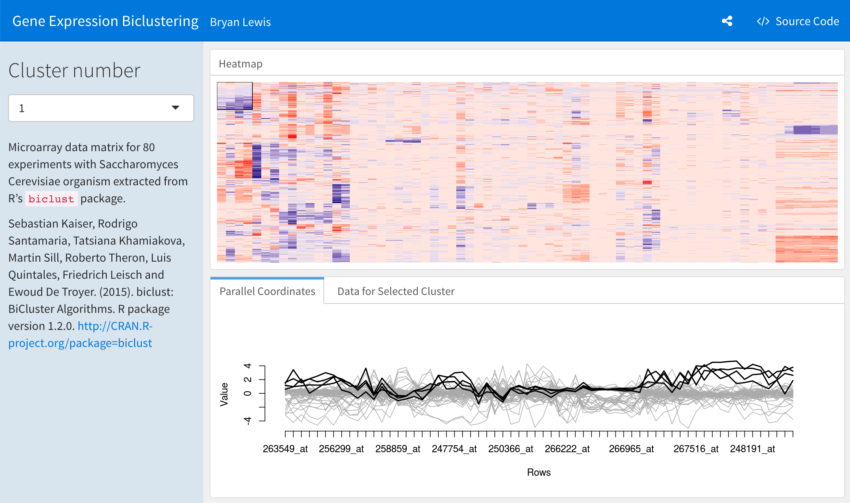
Dashboards visualize key data on demand
Notes:
Dashboards visualize key data on demand. This allows domain experts, who are often not trained in performing analytics, to quickly find essential information to do their work.

Slide 4
Turn an R Markdown document into an interactive dashboard
Notes:
Here it comes in handy if you’ve coded you analysis reproducibly in R Markdown – because there’s flexdashboard, an R package that allows you to turn an R Markdown document into an interactive dashboard.

Slide 5
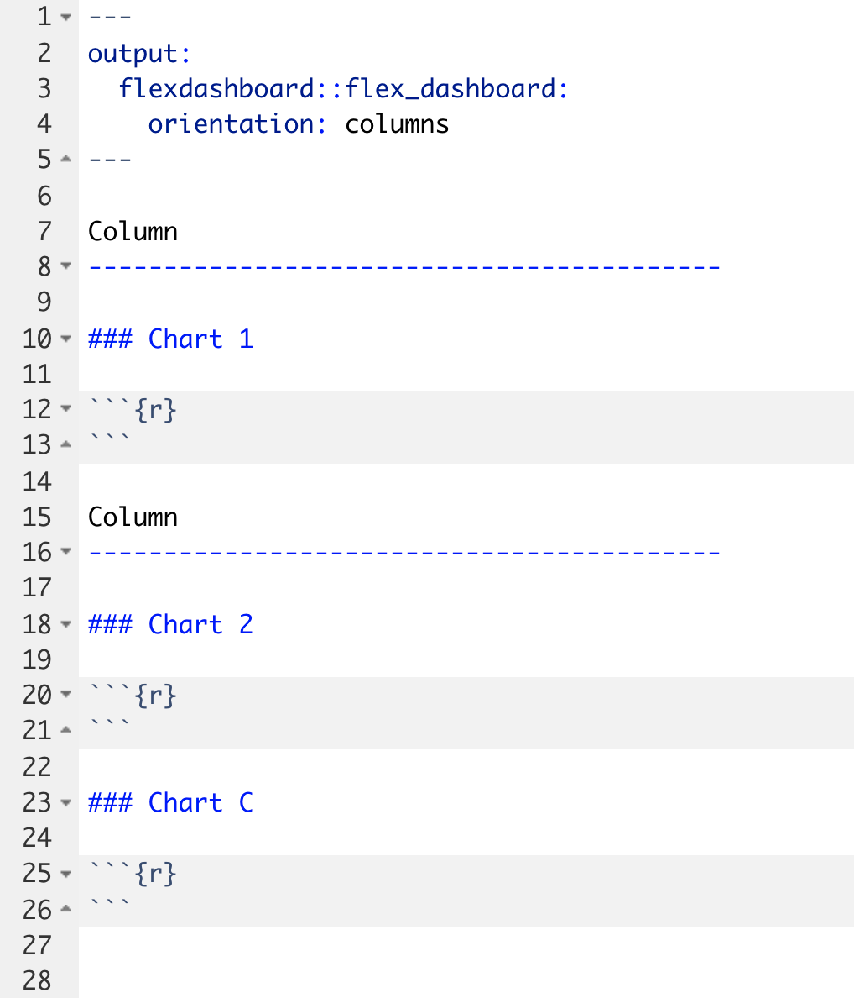
Notes:
When you create a new flexdashboard, it will automatically generate some code. Some of this should look familiar. You have the header that starts and end with 3 dashes - what's new is that the output is no longer an html_document, it's a flexdashboard. Also note that there is another option specified: orientation: columns. This is how you tell flexdashboard that you want the content organized in columns.
All the content of the dashboard goes below the header.
To add a column, you write “Column” and a whole bunch of dashes (at least 5 I believe). It actually doesn’t matter whether you write “Column” here, but by convention this is what people do to remind themselves that you’re organizing your dashboard into columns.
This is actually a different way to write a level-2 heading in R Markdown, which
To add a chart inside a column, add a level-3 header – by writing a line starting 3 hashtags – followed by the name of the chart.
In this case, we’re adding two columns. The first column has one chart in it, labeled “Chart 1”, and the second has two charts in it, labeled “Chart 2” and “Chart 3"
It’s not important that you remember exactly how to define columns or charts. Usually you will start with a template and then add content to it.

Slide 6
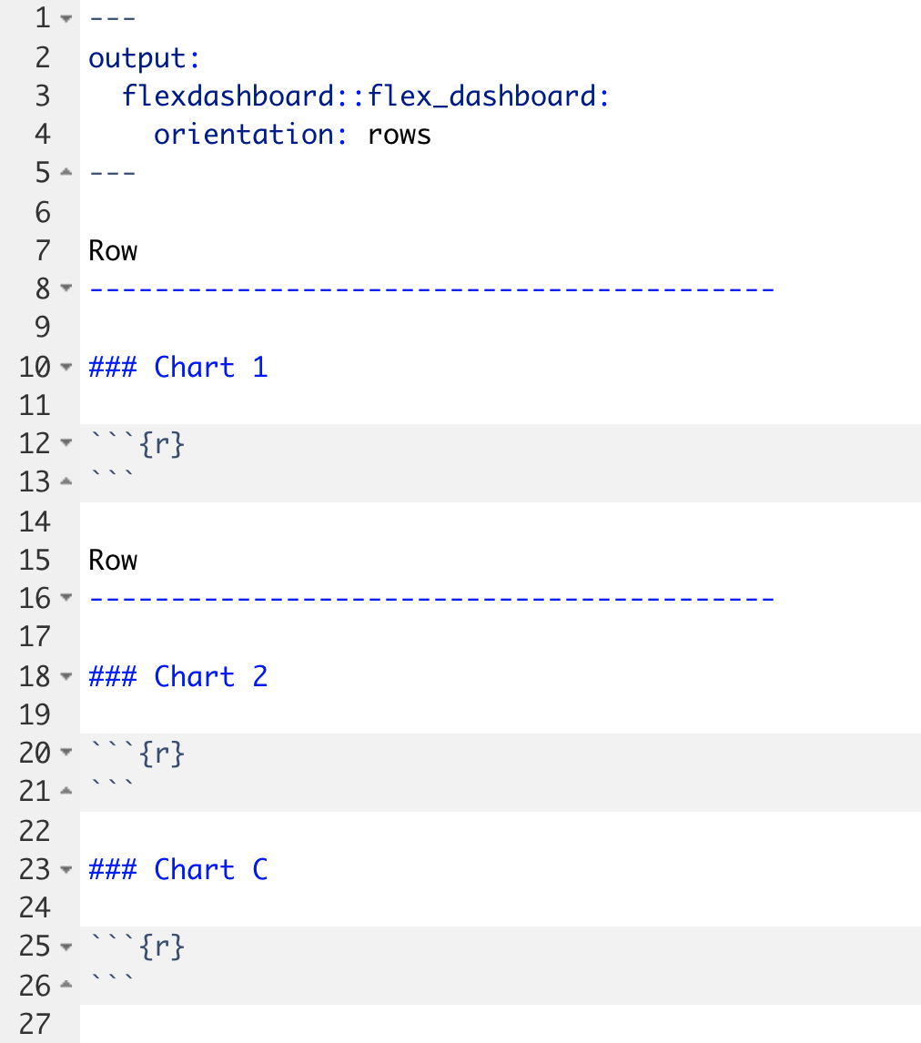
Notes:
If you want to change your chart to be primarily organized as rows, all you have to do is to change the orientation: field in the header to “rows.”
To remind yourself that your dashboard is organized in rows, you should also change the level-2 header to say “Row” although that isn’t strictly necessary.

Slide 7
Your Turn #1
Open 04 – Dashboards.Rmd to work with a draft COVID19 flexdashboard. RStudio will open the file in ”Source” mode so this will look a little different than your previous Quarto files. Don’t fret – this R Markdown file works the same as Quarto! Do the following:
Knit the document to see what the dashboard looks like. You may need to hit “Try Again” if you see a pop-up window.
Change the Test Volumes Over Time plot so that it visualizes the fraction of positive tests on a given day. (Hint: map the fill aesthetic to result). Knit the document again and note the change.
Change the layout from columns to a row orientation. Knit the document again and note the change.
Type “done!” in the chat when you are finished!

Slide 8
Making plots interactive
Notes:
A very common feature that you find in many dashboards and make them more user friendly is to make them interactive – by allowing users to hover over specific places to find out more information, and zoom into the data.

Slide 9
Plotly makes ggplots interactive
ggplot(data = data_frame) +
geom_function(mapping = aes(mappings))
my_plot <- ggplot(data = data_frame) +
geom_function(mapping = aes(mappings))
ggplotly(my_plot)
Notes:
Plotly is a package that provides functionality to make ggplots interactive.
Step 1. Start with the ggplot template for making any kind of plot
** Step 2. Capture the ggplot in an object. For example, here I capture the plot as an object named “my_plot”
** Step 3. Write ggplotly(my_plot)
And under the hood, plotly works by generating HTML and JavaScript code that gets embedded into the dashboard website.

Slide 10
Your Turn #2
Return to 04 – Dashboard.Rmd.
Make the Test Volumes Over Time plot interactive.
Knit the document again to note the change. Hover over the interactive plots. Note what happens when you click on the various buttons that appear above the plot.
Type “done!” in the chat when you are finished.
Notes:
(Show how I can turn off invalid and negatives to just focus on positives!)

Slide 11
Interactive tables
Notes:
Another very common element in dashboards are interactive tables.

Slide 12
DT makes data frames interactive
covid_testing
covid_testing %>%
datatable()
Notes:
We can use the DT package to turn a data frame into an interactive table.
This is even easier than plotly.
Step 1. Start with the data frame you’d like to show
Step 2. Pipe it to the function datatable() which is part of the DT package.

Slide 13
Your Turn #3
Return to 04 – Dashboards.Rmd. Let’s try to display a list of positive results in the Details of Positive Test Results area of the plot.
Note that this area currently shows the contents of the covid_testing data frame but doesn’t actually filter for positive results. Add to the pipeline a filter() statement that selects only those rows where the result value is "positive" (Hint: "positive" must be in quotes). Knit the dashboard and note the change.
In order to use the datatable() function, we first need to load the DT package. Add a line to the setup chunk (all the way on top!) to load the DT package.
Now make the table interactive! Knit the dashboard and note the change.
Type “done!” in the chat when you are finished!

Slide 14
Add styling

Slide 15
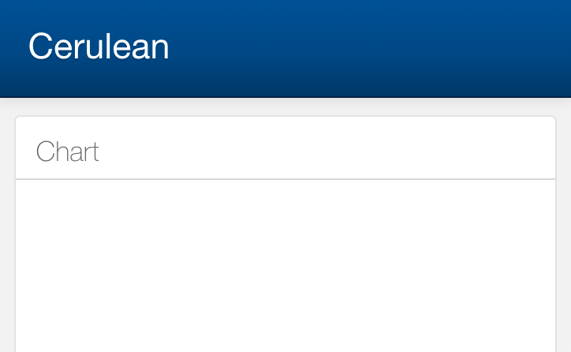
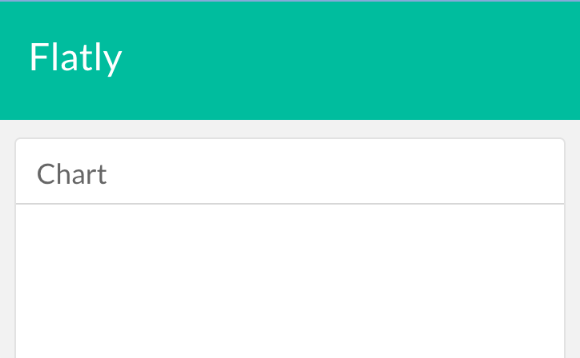
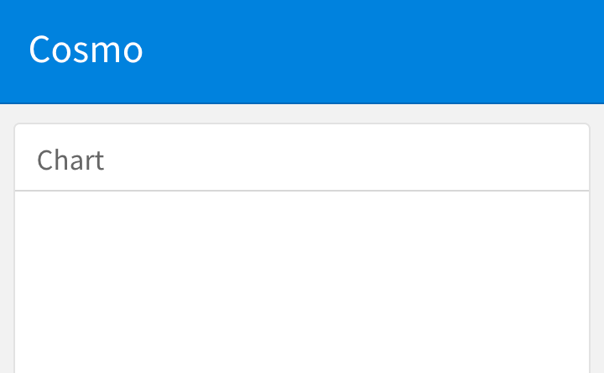
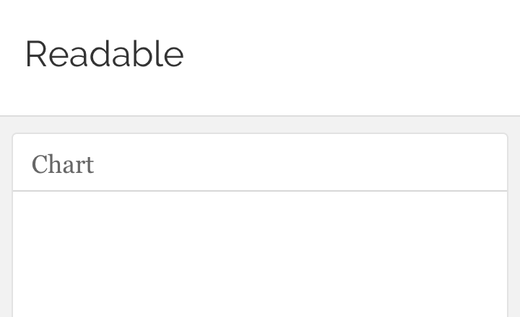
Notes:
There are a few themes that are included with flexdashboard by default.

Slide 16
Adding a theme
---
title: "My Dashboard"
output:
flexdashboard::flex_dashboard:
orientation: rows
theme: cerulean
---
https://rmarkdown.rstudio.com/flexdashboard/using.html#themes
Notes:
Under the hood, themes use a technology called CSS or cascading style sheets. But all of this is abstracted away, and all you have to do is add a theme definition in the header of the Rmd document.
This really becomes useful when your organization has created a CSS style sheet that conforms to brand guidelines; can often find those and directly use in flexdashboard.

Slide 17
COVID19 Dashboard Hackathon!
Notes:
In this last exercise of the workshop, we will again send you into breakout rooms. Your TA will share their screen with the COVID19 flexdashboard source code open. The objective is to work as a team to tweak the dashboard using the tools we covered today. In 15 minutes we’ll bring everyone back and take a look at what each group has built!
Remember: your TA probably isn’t a flexdashboard expert, and there’s only going to be 15 minutes. But there are a couple of improvements you can make with the tools we’ve covered today, for example the style, or you might want to add another graph or table, or add a column to the table, or change the color theme of the graph, or tweak the axis labels to make them more descriptive. Have fun!

Slide 18
Recap
Turn R Markdown documents into interactive dashboards with flexdashboard
Turn ggplot objects into interactive plots with plotly
Turn data frames into interactive tables with DT

Slide 19
What else?

Slide 20
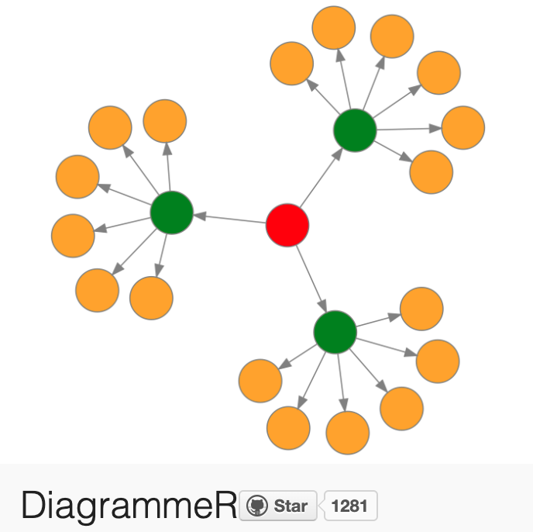
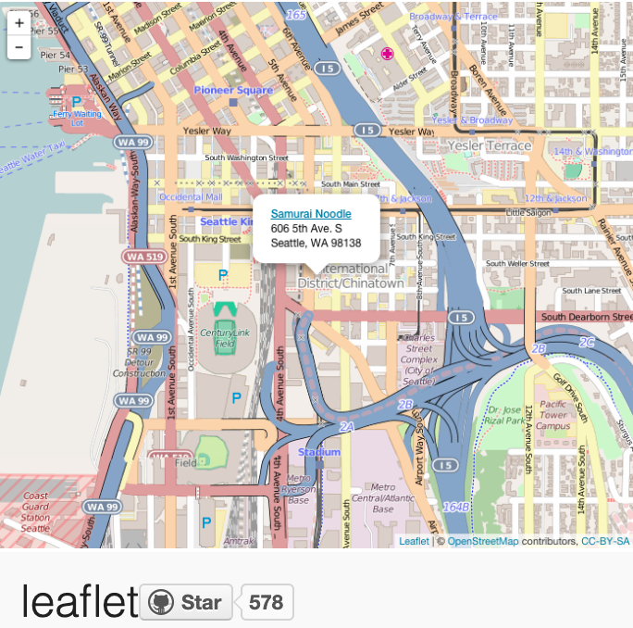
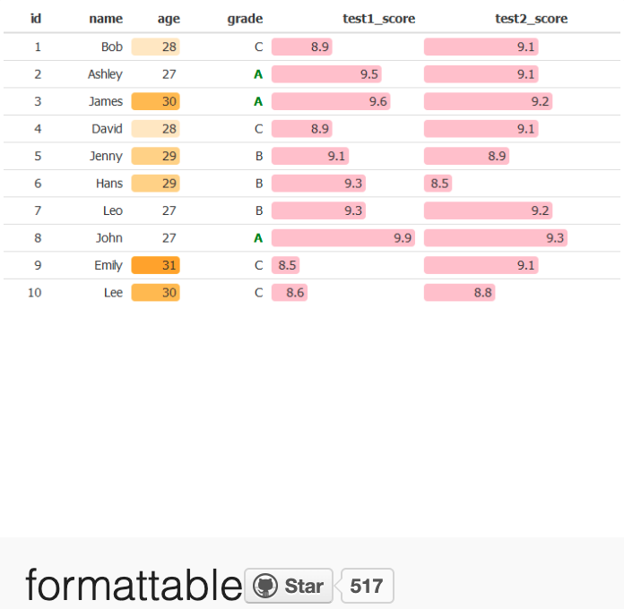
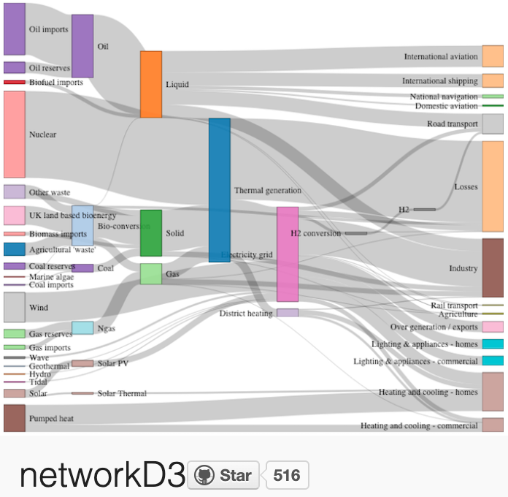
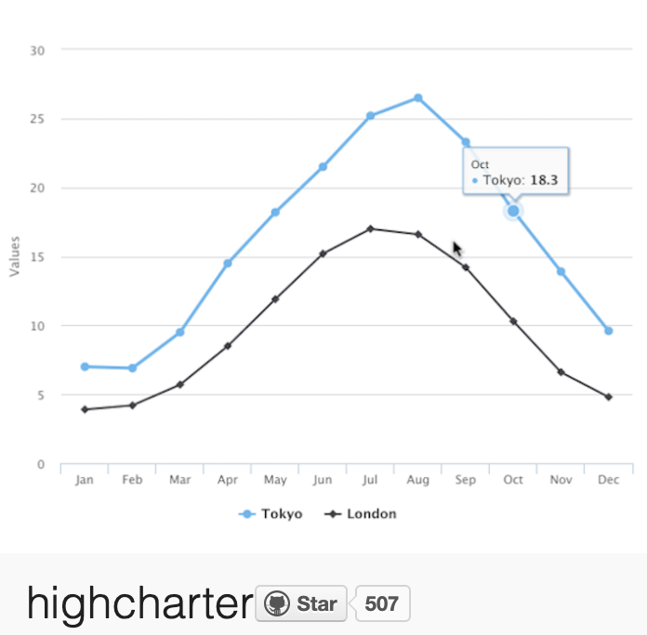
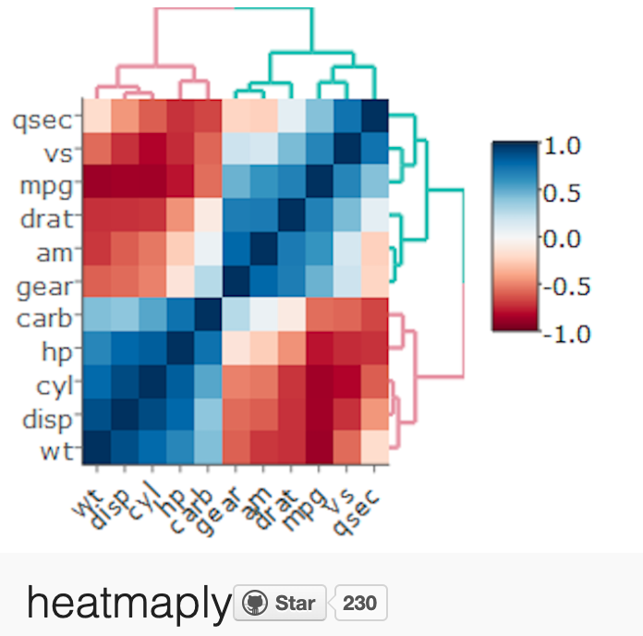
More interactive charts
https://gallery.htmlwidgets.org/

Slide 21
A framework for developing interactive web applications in R

Slide 22


Deploying dashboards and web apps
Shinyapps.io (free)
Shiny Server (free)
RStudio Connect ($)

Slide 23
What next?

Slide 24

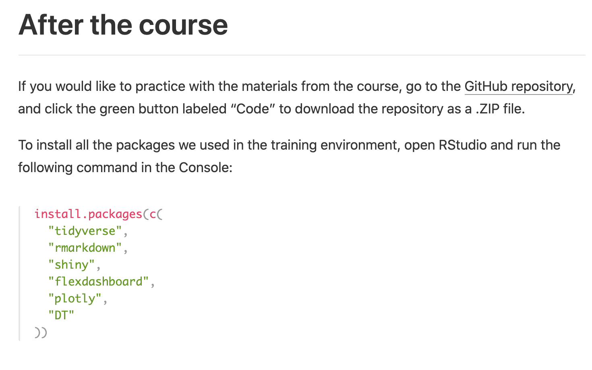
Install R and RStudio on your computer!
https://hannar1.quarto.pub/rmedicine-101-intro-to-r-for-clinical-data/

Slide 25

https://r4ds.hadley.nz/
Notes:
The “R For Data Science” book by Garrett Grolemund and Hadley Wickham has become the de-facto standard introduction to data science with R with best practice and ease of learning in mind. The entire text is available for free at this address. Each chapter has a lot of exercises, which I encourage you to do.

Slide 26
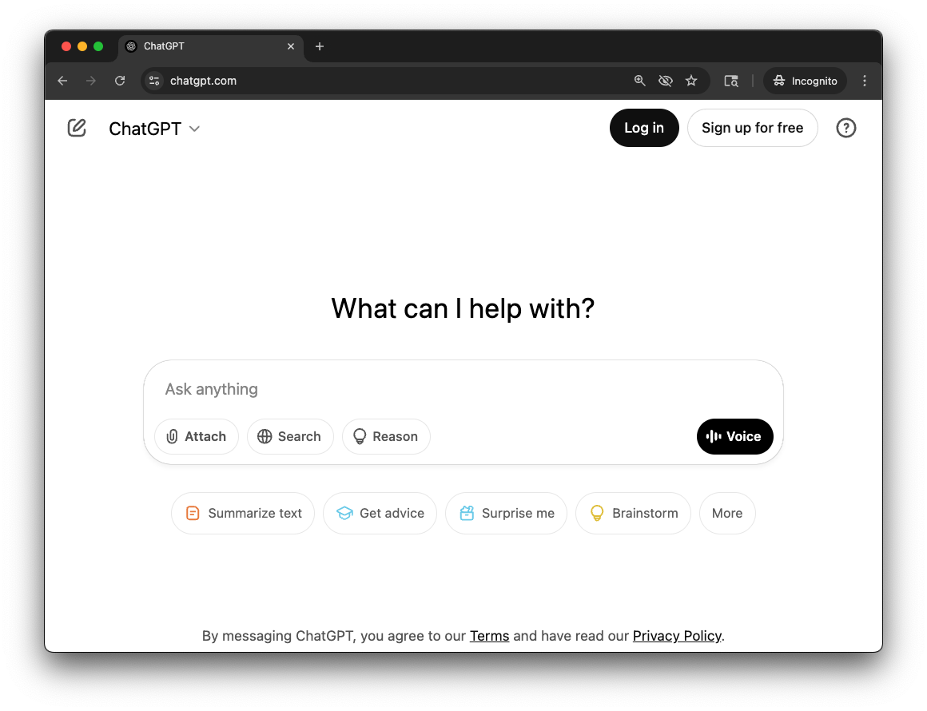
What should I do when I get stuck?
DO NOT ENTER:
Protected Health
Information
Personally Identifiable
Information
Proprietary or Confidential
Institutional Information
Notes:
We used to recommend a strategy of googling and looking at the cheat sheets. We no longer recommend this. Instead, we strongly recommend you use generative AI like ChatGPT. Even the free version that you can access without having to make an account is good enough to help you troubleshoot your R code.
One word of caution however: When you use a public LLM, NEVER enter any Protected Health Information, Personally Identifiable Information, or Proprietary or Confidential Institutional Information. My rule of thumb is, if I have to think about whether anything falls into one of the above, don’t enter it!

Slide 27
Thank You TAs!
Alex Peters
Roni Devassy

Slide 28
Thank You!

